Slide 1
Chapter 6 Color Image Processing
Part 2 Pseudo color Image Processing

Slide 2
6.3 Pseudocolor Image Processing ['sjuːdəʊ] 】
Very Useful Tool for Data Visualization
Input f(x,y): gray scale image
Output gc(x,y): color image
gc(x,y) = {r(x,y),g(x,y),b(x,y)}
r(x,y) = R(f(x,y))
g(x,y) = G(f(x,y))
b(x,y) = B(f(x,y))

Slide 3
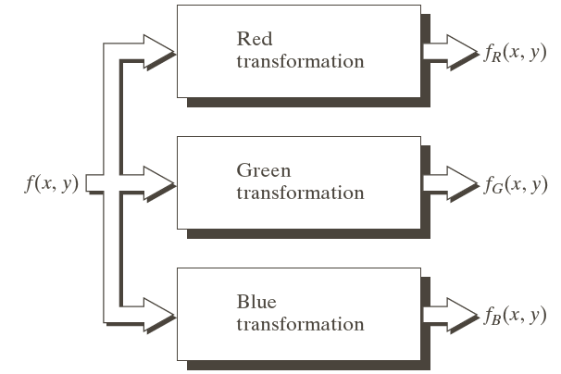
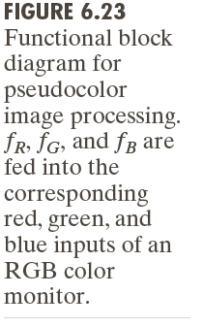
6.3 Pseudocolor Image Processing

Slide 4
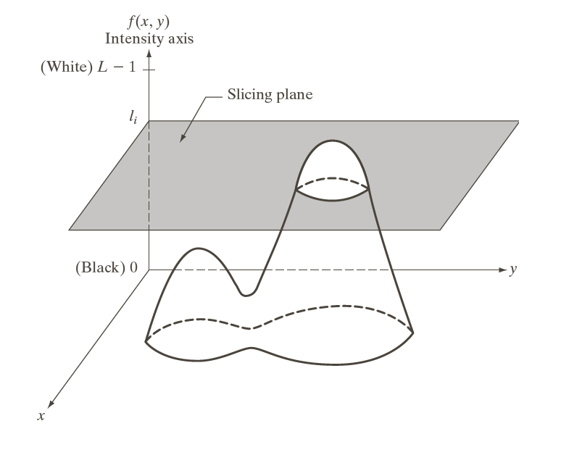
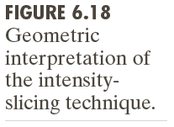
Pseudocolor Image Processing
Intensity Slicing

Slide 5
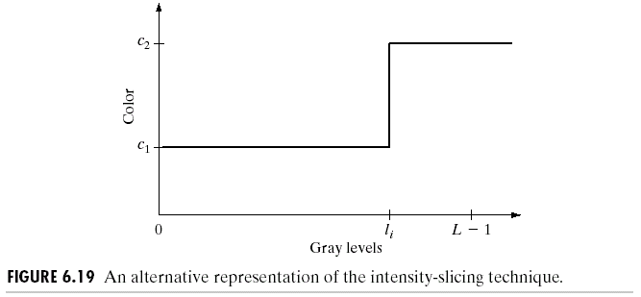
Pseudocolor Image Processing
Intensity Slicing

Slide 6
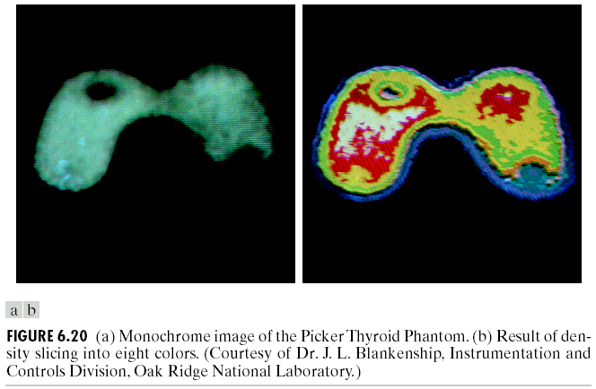
Pseudocolor Image Processing
Intensity Slicing

Slide 7
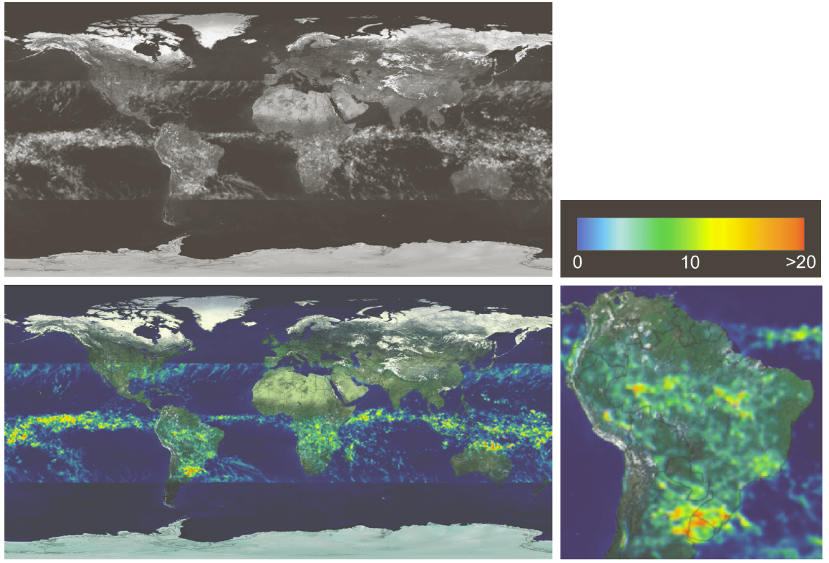
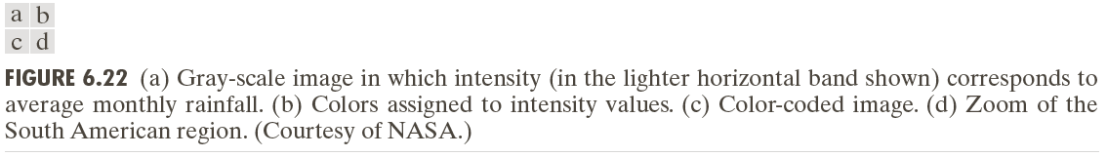
Pseudocolor Image Processing

Slide 8
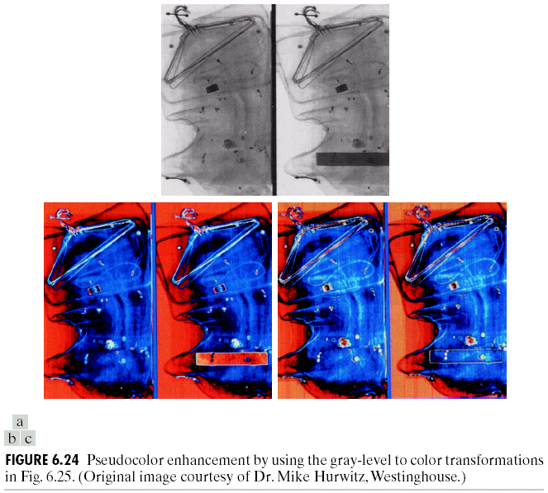
Pseudocolor Image Processing

Slide 9
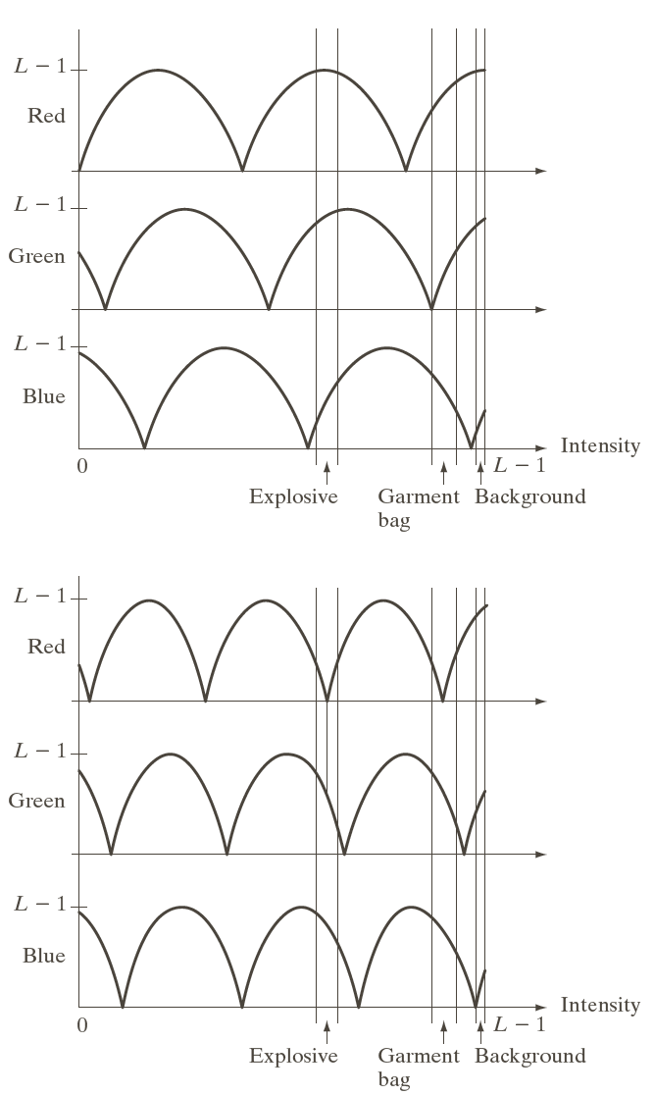
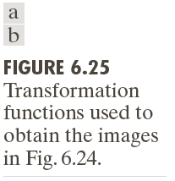
Pseudocolor Image Processing

Slide 10
6.4 Full Color Image Processing
6.4.1 Fundamentals
What is full color image processing?
Input f(x,y): Color Image
Output g(x,y):Color Image

Slide 11
6.4 Full Color Image Processing
6.4.2 Based on RGB Model
Input: {fr(x,y),fg(x,y),fb(x,y)}
Output
gr (x,y) = T(fr(x,y));
gg(x,y) = T(fg(x,y));
gb(x,y) = T(fb(x,y));
T: Basic Intensity transform, average blur,Gaussian Blur,Sharpening Filter

Slide 12
6.4 Full Color Image Processing
6.4.2 Based on RGB Model
Input: {fr(x,y),fg(x,y),fb(x,y)}
Output
gr (x,y) = Tr(fr(x,y));
gg(x,y) = Tg(fg(x,y));
gb(x,y) = Tb(fb(x,y));
Adjust some channels

Slide 13
6.4 Full Color Image Processing
6.4.3 Based on HSV Model
Hue/Saturation/Value Model
V=max(R,G,B)
S=(max-min)/max
if R = max, H = (G-B)/(max-min)
if G = max, H = 2 + (B-R)/(max-min)
if B = max, H = 4 + (R-G)/(max-min)
H = H * 60
if H < 0, H = H + 360

Slide 14
6.4 Full Color Image Processing
if s = 0
R=G=B=V
else
H /= 60;
i = INTEGER(H)
f = H - i
a = V * ( 1 - s )
b = V * ( 1 - s * f )
c = V * ( 1 - s * (1 - f ) )
switch(i)
case 0: R = V; G = c; B = a;
case 1: R = b; G = v; B = a;
case 2: R = a; G = v; B = c;
case 3: R = a; G = b; B = v;
case 4: R = c; G = a; B = v;
case 5: R = v; G = a; B = b;

Slide 15
6.4 Full Color Image Processing
6.4.3 Based on HSV Model
V Channel: Gray level Image Processing: Intensity transform,
average blur
Gaussian Blur
Sharpening Filter
Histogram Equalization

Slide 16
6.4 Full Color Image Processing
6.4.3 Based on HIS (HSV) Model
S Channel:
Increase or Decrease Saturation

Slide 17
6.4 Full Color Image Processing
6.4.3 Based on HSV Model
H Channel:
add operation: change image hue

Slide 18
6.4 Full Color Image Processing
6.4.3 Based on YUV Model
Y Channel: Gray level Image Processing: Intensity transform,
average blur
Gaussian Blur
Sharpening Filter
Histogram Equalization

Slide 19
6.4 Full Color Image Processing
6.4.3 Based on Color Transform Matrix

Slide 20
6.4 Full Color Image Processing
6.4.3 Based on Color Transform Matrix
RGB to Gray
Brightness Adjust
Saturation Adjust
Color Balance

